Slide 1

Connectors
“and”, “but”, “so”, “because”
Miss Angélica Arévalo Rivera
Miss Rayen Romann
2 nd grade high school
2020

Slide 2
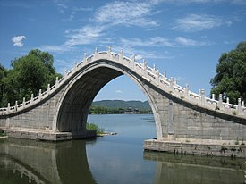


CONECTAR

Slide 3
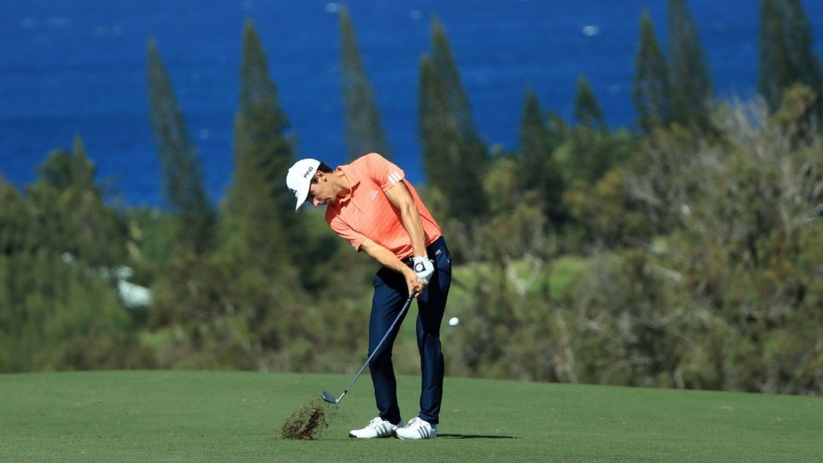

EJEMPLO :
MY FIRENDS PLAY GOLF I PLAY SOCCER
AND

Slide 4
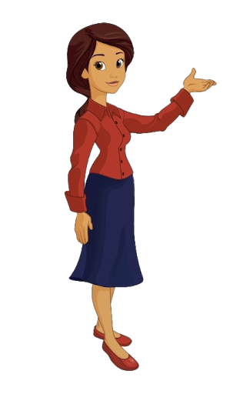
CONNECTORS
LOS CONECTORES SON PALABRAS QUE SE UTILIZAN PARA UNIR IDEAS U ORACIONES. OBSERVA EL MAPA RESUMEN EN LA PRÓXIMA DIAPOSITIVA

Slide 5
Connectors
Link sentences/ideas
Unir ideas /oraciones
and
but
because
so
Add information
(agregar)
Contrast
(contrastar información opuesta)
Reason
(dar la razón de algo)
Result/consequence
(Resultado de algo)
EXAMPLES
1. I enjoy playing football, basketball and tennis.
2. I like football but I don’t like tennis.
3. I like football because it is entertaining.
4. I like football so I will play.

Slide 6
I. CHOOSE the correct connector.
1. I want to stay so / because / but I have to catch my bus.
2. I am so hungry so / and / but I will buy a sandwich.
3. I only passed my exam because / but / and you helped me.
4. We can go to the pool and / but / because swim.
5. I have an important test and / so / but I will study.
6. I’m so happy so / because / but it is my birthday.

Slide 7
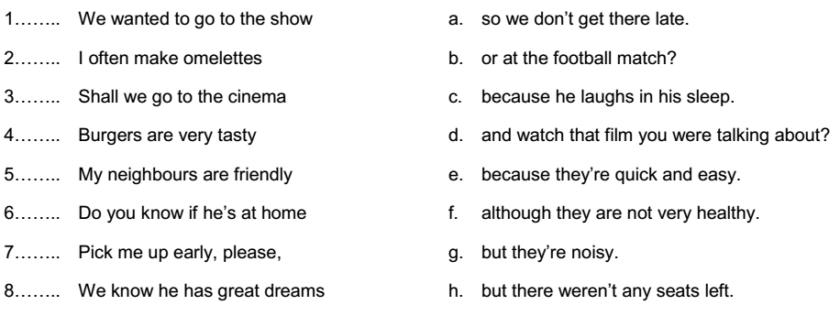
II. MATCH the sentences from 1 to 8 with the coorect ones from a to h.

Slide 8
III. Create 1 sentence with each connector.
«and»__________________________________________
«but»__________________________________________
«because»______________________________________
«so»___________________________________________

